Slide 1

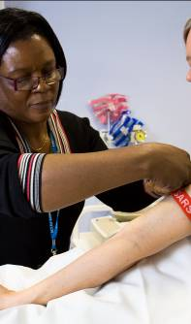






Inês Barroso
Introduction to genetic epidemiology
Genetic Studies of Type 2 Diabetes and Obesity
Cambridge Diabetes Seminar, 2019
Notes:
Background – brief: genes – identify new targets or offer insight into existing ones.
Study design (Nelson) - exome sequencing of genes encoding drug targets for obesity and T2D
Slide overall study design (alpha?)
Discovery results
Follow-up results
GLP1R
what is it? Incretin effect – drug target for T2D (new therapy – glucose control – like all – CV safety to be shown (increase in HR) – currently uncertain. Some other uncertainties over safety – concerns over pancreatitis/pancreatic cancer
mutation – what does it do? Unknown – previous characterisation unclear – attempts to characterise it in beta cells unsuccessful.
FG effect size – minor allele lower FG.
Investigate association with T2D – minor allele lower risk – Variant = therapy
How about mirroring other effects of GLP1R?
Dan slide – no differences, although admittedly underpowered to detect small effects. (animated***)
Seems we have a good variant – can we predict safety?
CV disease – minor allele = drug effect – lower risk
How about for other diseases? – pancreatic – not informative.
Conclusions – Dan.

Slide 2
Overview
Part 1: Genetic Epidemiology
  What is Genetic Epidemiology?
  Different effects of genes on disease
  Gene-Environment Interactions
  Genetic approaches to study disease
    Genetic studies of complex traits pre-Genome-Wide Association Studies (GWAS)
Part 2: Genetic Studies of Diabetes and Obesity
  What have we learned from GWAS?

Slide 3
Genetic Epidemiology
Study the role of genes in determining or influencing health and disease risk, in families and in populations
Understand the interplay between genetic and environmental factors in influencing health and disease

Slide 4
Genes and Environment in Disease
Infectious Disease
Environment
Obesity
Type 2 Diabetes
Monogenic (MODY, NDM)
Genes
Notes:
As a way of introduction, genes and environment play a different role in different diseases. So at one extreme we may have infectious diseases where the exposure to pathogens in the environment may be the main driving force, and at the opposite end of the spectrum we have Monogenic, or single gene disorders like cystic fibrosis where a mutation in a gene causes the disease. Nonetheless we are now well aware that even at the extremes both genes and environment play a role, e.g. CCR5 gene variant influences response to HIV infection and exposure to Phenylalanine influence PKU. In between the two extremes are a set of traits and diseases known as complex where it is the interplay between the environment and predisposing genes that influence disease risk.

Slide 5
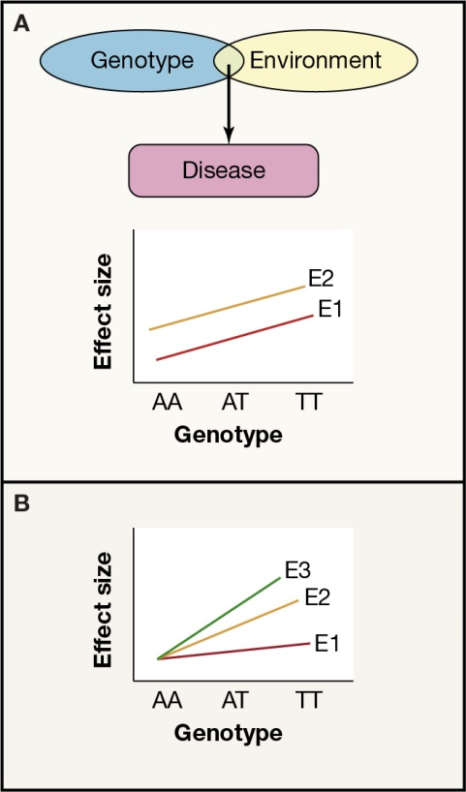
Genes and Environment
Additive Effects
Multiplicative or
Interaction Effects (GxE)
Barroso and McCarthy, Cell 2019

Slide 6
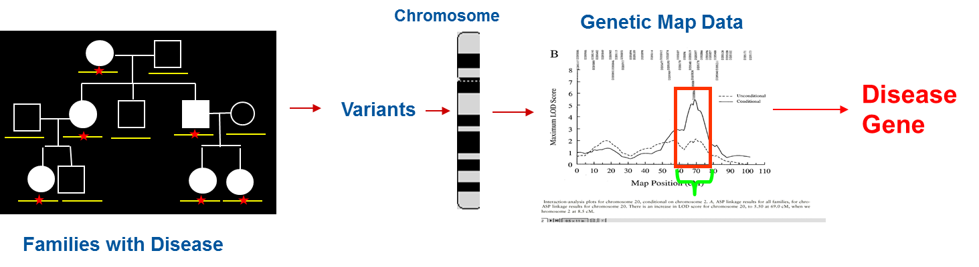
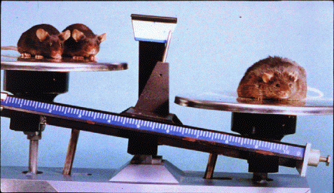


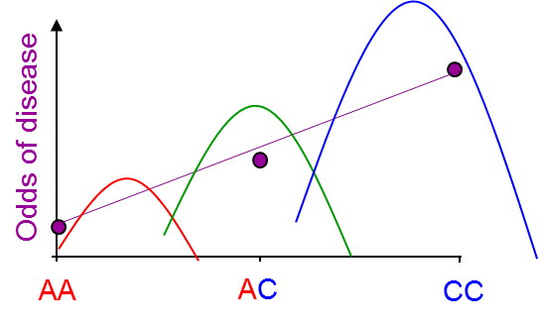

Changing Genetic Approaches I
Family Linkage
ob/ob– leptin deficient mouse
Candidate Gene
Human LEP orthologue
Re-sequence in affected individuals
Disease Gene
Mutation
Zhang et al. Nature, 1994
Genome-Wide Association Study (GWAS)
1K- 500K individuals
Populations or affected (cases) – unaffected (controls)
500K-1M variants
Variant association with disease
Notes:
What changed?
Moved from linkage and candidate gene studies to what has become the work horse of complex disease/ trait genetics, the genome-wide association study, or GWAS approach. In which many 100s of Kss markers are tested for statistical association with disease or with a continuous trait in a statistically robust framework.

Slide 7
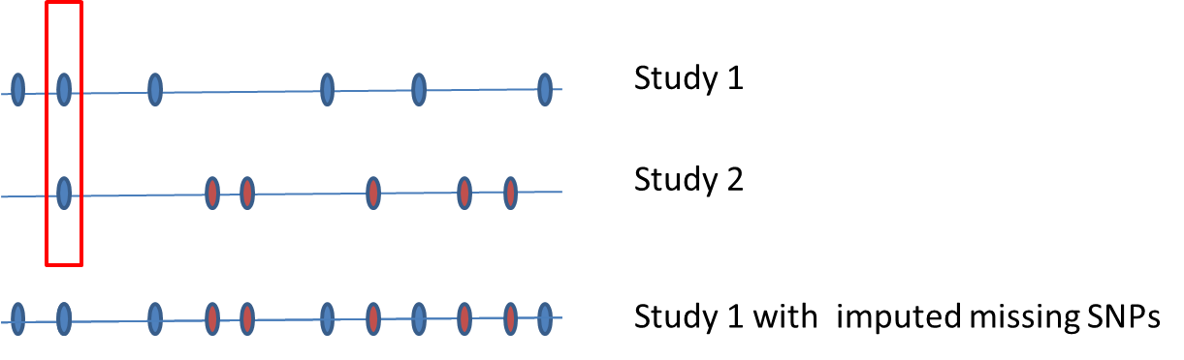
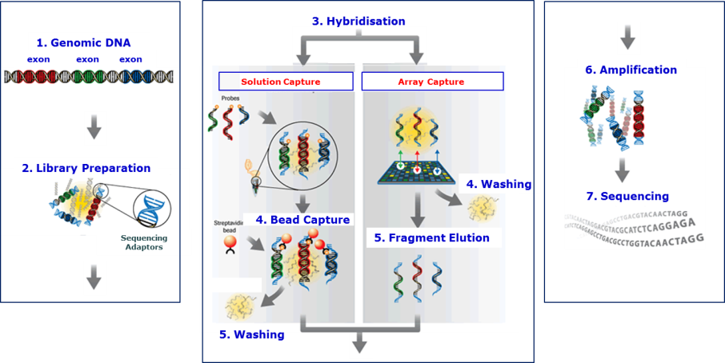
Changing Genetic Approaches II
GWAS 1
International GWAS
Consortia
GWAS 2
Large Scale Meta-Analysis
GWAS 3
GWAS…
GWAS+ Imputation Dense Reference Panel
Whole-Exome and Whole-Genome Sequencing
Notes:
This evolved to become large international consortia (no study no matter how large a study it is not large enough on its own to be sufficiently powered), with denser or custom genotyping arrays, the development of highly dense reference panels based on sequence data from Kss of individuals, allowing testing of less frequent alleles (perhaps 0.1%) and more recently the move towards whole- exome and whole-genome sequencing approaches.

Slide 8
Genetic Applications
Disease aetiology and causality
Highlighting biological pathways underlying normal physiology and pathophysiology
Identification and validation of drug targets
  Novel target discovery and genetic validation
  Drug repurposing
Pharmacogenetics
  adverse drug response
  responders vs non-responders
Disease risk prediction
Patient stratification

Slide 9
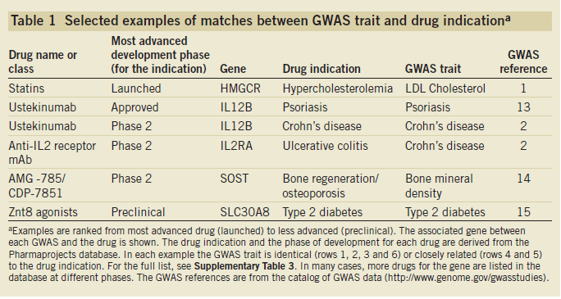
Matching Genetic Loci Associated with Disease with Drug Targets
Sanseau et al., 2012

Slide 10
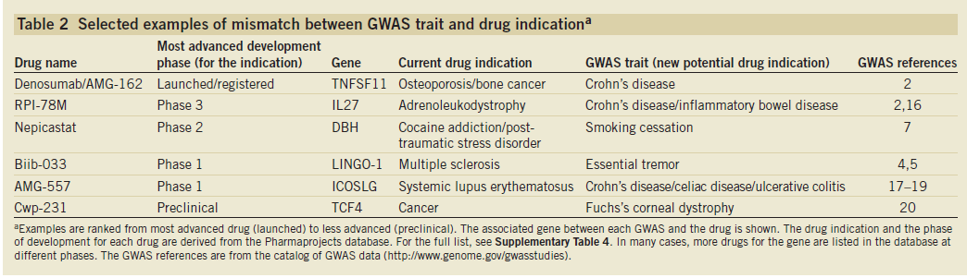
Drug Repurposing
Sanseau et al., 2012

Slide 11
Genetic Studies of Type 2 Diabetes and Obesity

Slide 12
Disease Gene Identification
Loci for Mendelian forms of diabetes and obesity found
  Maturity Onset Diabetes of the Young (MODY), Neonatal Diabetes Mellitus (NDM), severe early onset forms of obesity, monogenic forms of insulin resistance
  However…
Complex Diseases (T2D, common obesity) > 10 years of little progress
  Linkage and candidate gene studies did not yield many robustly associated loci
  Studies were usually small and underpowered
  Statistically lenient
  Lots of “false positives”
Notes:
Early disease gene identification was successful mostly in finding genes for mendelian forms of diabetes and obesity and for many years there was little progress in complex disease genetics (this was true for all complex diseases and traits not just diabetes and obesity). This was partly because methods used to find mendelian genes did not really work for this complex traits, studies often were very small 50 cases and 50 controls (!!), statistically lenient p<0.05 is just 1/20 false-positive which did not account for the many hypotheses being tested. Led to false-positives.

Slide 13
Genetic Landscape of Type 2 Diabetes (T2D) pre-GWAS
Legend
Candidate gene/ LD mapping
GWAS era begins
TCF2
PPARG
KCNJ11
TCF7L2
WFS1
2000
2001
2002
2003
2004
2005
2006
2007
2008
2009
2010
Notes:
So this was what was known about the genetic architecture of T2D before GWAS: only five loci robustly associated with T2D risk were known;

Slide 14
Genetic Landscape of Common Obesity pre-GWAS
Large-scale custom arrays available- metabochip
GWAS Meta-Analysis era begins
GWAS era begins
2000
2001
2002
2003
2004
2005
2006
2007
2008
2009
2010
Notes:
And for obesity there were no loci known to influence risk of common obesity…

Slide 15
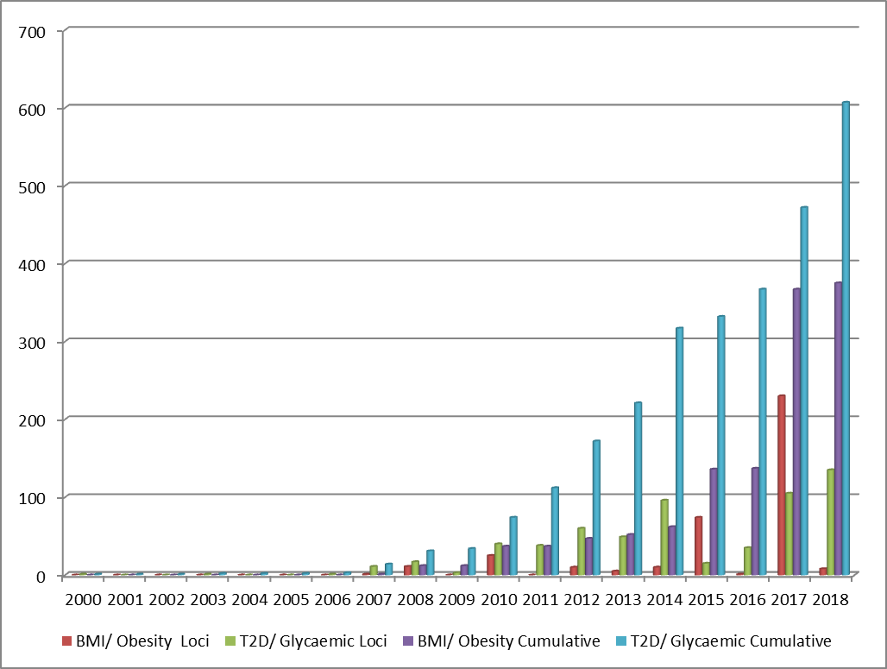
T2D and Obesity Genetic Loci
Sequence based association studies
First exome array studies
Large-scale custom arrays - metabochip
GWAS Meta-Analysis era begins
GWAS era begins
Post-GWAS
Susceptibility loci for T2D/glycaemic traits increased from 5 to >600, and 0 to >350 for BMI/obesity.
Notes:
So what have these changes allowed us to find? The increasing sample sizes, inclusion of data from targeted arrays and from multiple different ancestries has led to a total of ~92 loci influencing T2D risk, over a hundred for obesity and similar numbers for underlying quantitative traits.

Slide 16

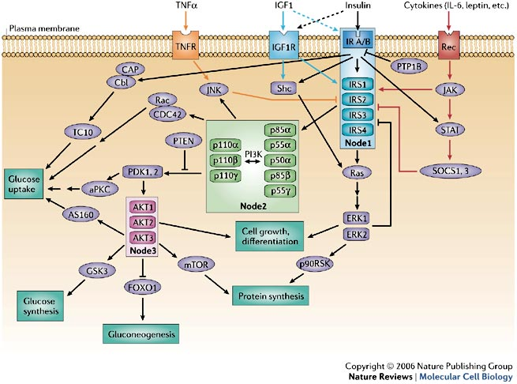

What can we learn from genetic studies?
Genetic Architecture
Architecture: "the complex or carefully designed structure of something”
Biological Insights
Translation
Notes:
But what have we learned from these studies?
Over the rest of my talk I will focus on three main aspects: genetic architecture, biological insights and clinical applications.
Genetic architecture – number, frequency and effect size of variants influencing a disease/ trait

Slide 17

What have we learned from genetic studies of type 2 diabetes and obesity?
Genetic Architecture
Architecture: "the complex or carefully designed structure of something”
Biological Insights
Translation
Notes:
But what have we learned from these studies?
Over the rest of my talk I will focus on three main aspects: genetic architecture, biological insights and clinical applications.
Genetic architecture – number, frequency and effect size of variants influencing a disease/ trait

Slide 18
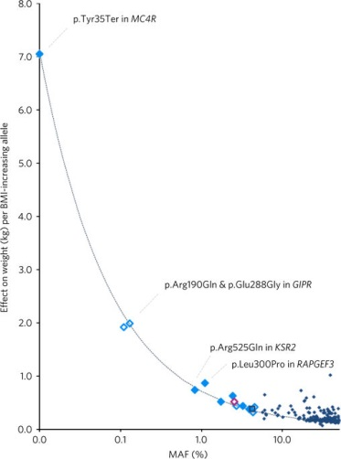
Genetic Architecture – What is it?
The number of loci influencing a disease/ trait, the minor allele frequency (MAFs) of risk/contributing loci, and their effect sizes on disease/ trait
To date
  Many contributing loci:
    >600 associated with T2D risk and/or glycaemic traits
    >350 associated with Obesity risk and/or BMI/related traits
  Most are common variants (MAF>5%) with small effect sizes
  Some rare variants may have larger effects
  Most variants map to non-coding sequence
    regulatory function
  Marked ethnic/ancestry heterogeneity is relatively uncommon though there are rare ethnic-specific variants
p.Tyr35Ter MC4R:
Carriers 1/5000
One of the first “monogenic” mutations described
>7kg heavier on average
20% carriers normal BMI
  As sample sizes increase can detect rarer alleles or those with even more modest effects
Turcot et al., 2018

Slide 19
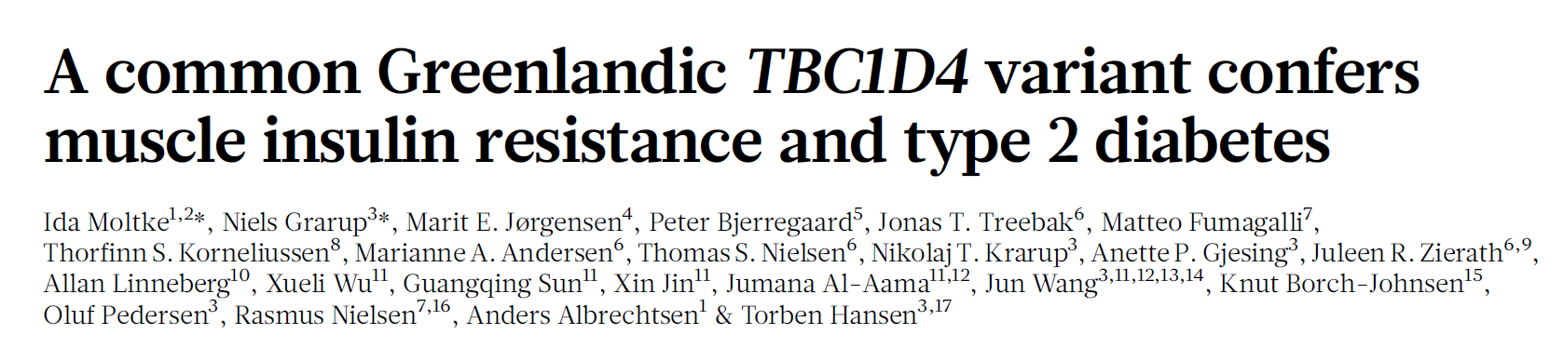
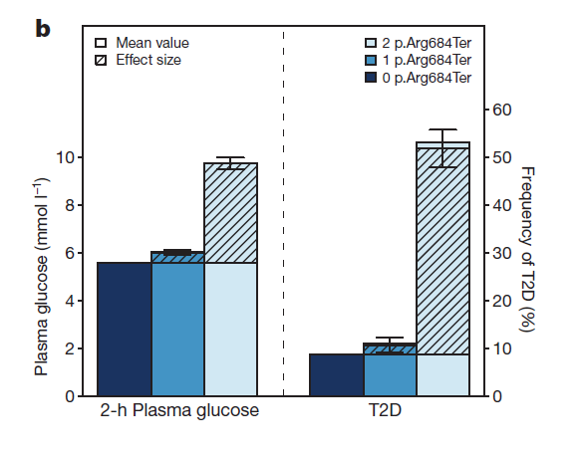
TBC1D4 Variants, Insulin Resistance and Diabetes
Variant, p.Arg684Ter in TBC1D4 associated with T2D risk in Greenlandic population (MAF=17% in Greenland 0% in European, OR= 10.3, P = 1.6 × 10⁻²⁴ , for homozygous), and accounts for 10% of T2D cases in Greenland
Notes:
One last example of translating from a rare disease to a common disease is in the TBC1D4 gene also known as AS160 which is a RAB-GTPase activating protein in the insulin signalling pathway. A few years back we described a mutation in this gene leading to a premature stop codon in a single proband with very severe postprandial hyperinsulinaemia, as shown in the graph here where the proband is shown in red compared to controls in black and a patient with insulin receptor mutation in blue for comparison.
Recently a very elegant study in the Greenlandic population from Torben Hansen and colleagues detect a different premature stop codon in the greenlandic population this was present with a MAFof 17% there but is monomorphic in Europeans and this variant conveys a 10-fold increase risk of diabetes, accounting for approx 10% of diabetes cases in greenland.

Slide 20
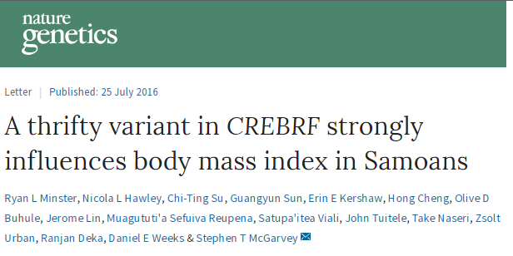
rs373863828 (p.Arg457Gln) MAF=25.9% in Samoans, virtually absent elsewhere
Dichotomous traits | n | OR (95% CI) | P | Covariatesª
Obesity (>32 kg/m²) | 3,066 | 1.305 (1.159–1.470) | 1.12 × 10⁻⁵ | A, A², S, A × S
Diabetes | 2,876 | 0.637 (0.536–0.758) | 3.86 × 10⁻⁷ | A
Diabetes adjusted for BMI | 2,861 | 0.586 (0.489–0.702) | 6.68 × 10⁻⁹ | A, B
Hypertension | 3,041 | 1.014 (0.898–1.145) | 0.818 | A, S
Boldface represents a P value <2.17 × 10⁻³. s.e., standard error; OR, odds ratio; 95% CI, 95% confidence interval.
ªA, age; A², age²; S, sex; A × S, age × sex interaction; A² × S = age² × sex interaction, B, log(BMI).

Slide 21
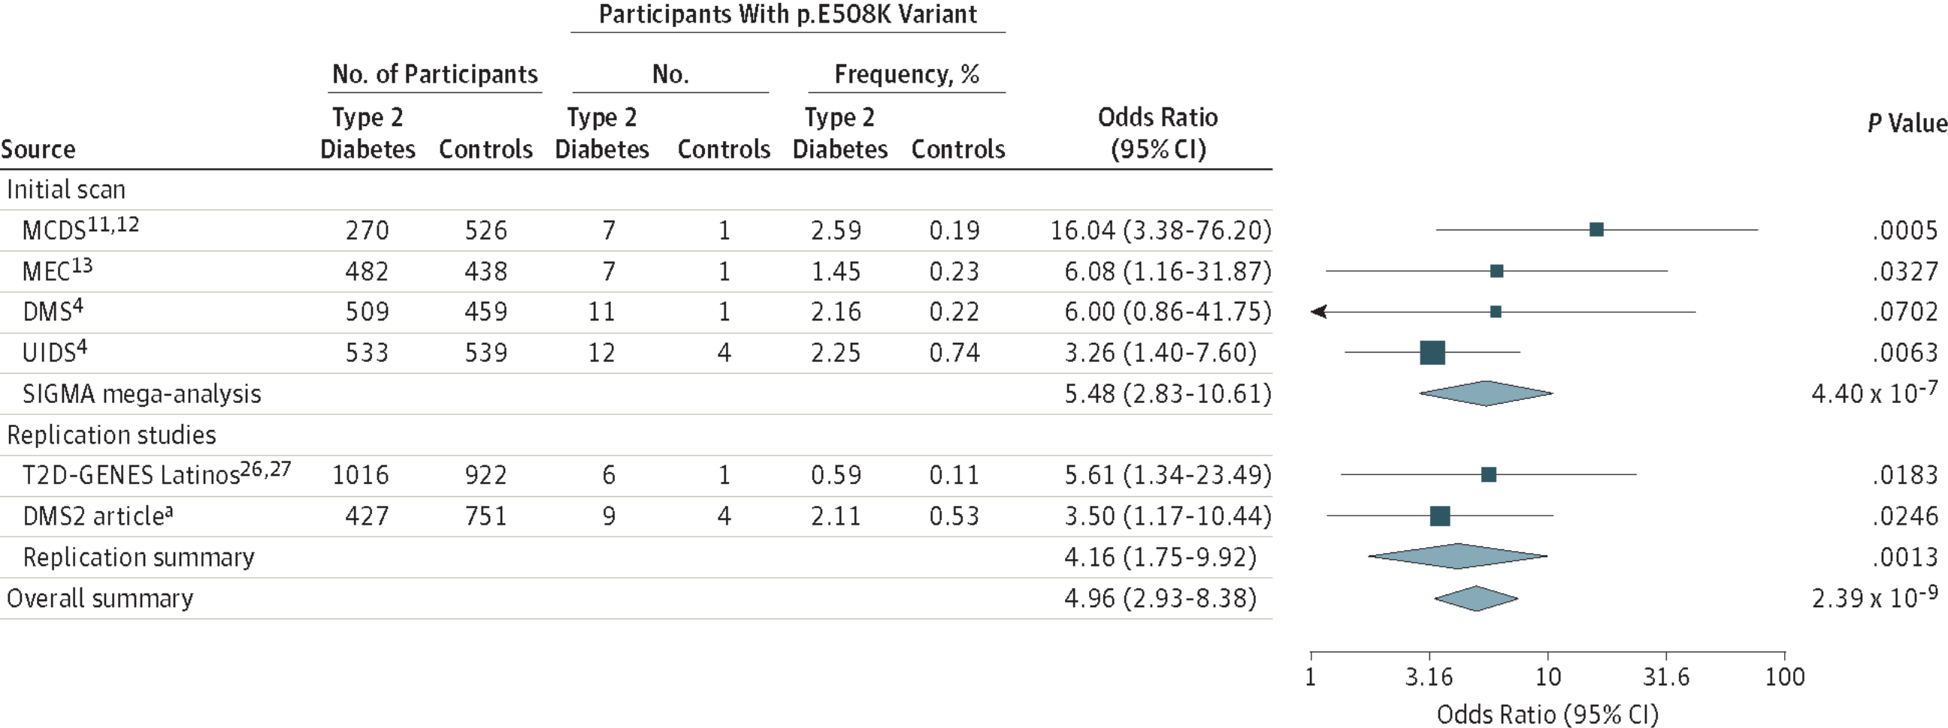
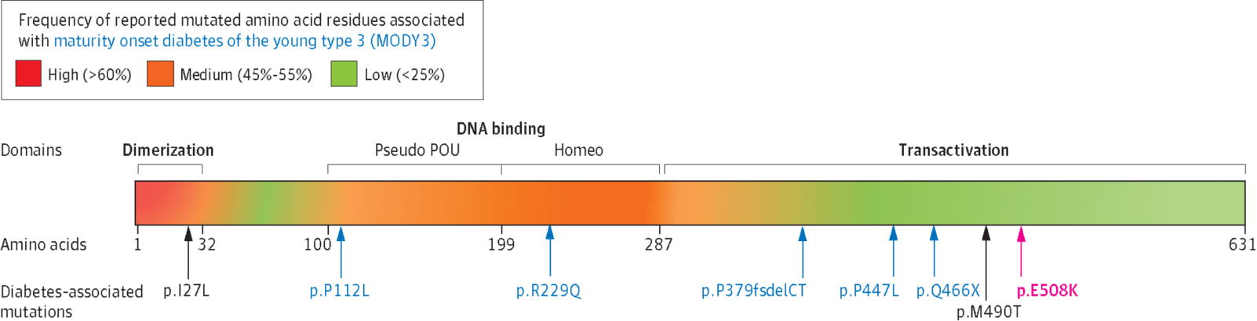
Rare Variant in HNF1A (MODY3) Associated with T2D in Latinos
Sigma Type 2 Diabetes Consortium, 2014
Notes:
Further work from the same consortium using WES sequencing of 3756 Mexican and US Latino individuals (1794 with type 2 diabetes and 1962 without diabetes) recruited from 1993 to 2013. ). Found missense variant in HNF1 (a mody gene) associated with diabetes risk.
In experimental assays, HNF-1A protein encoding the p.E508K mutant demonstrated reduced transactivation activity of its target promoter compared with a wild-type protein.

Slide 22
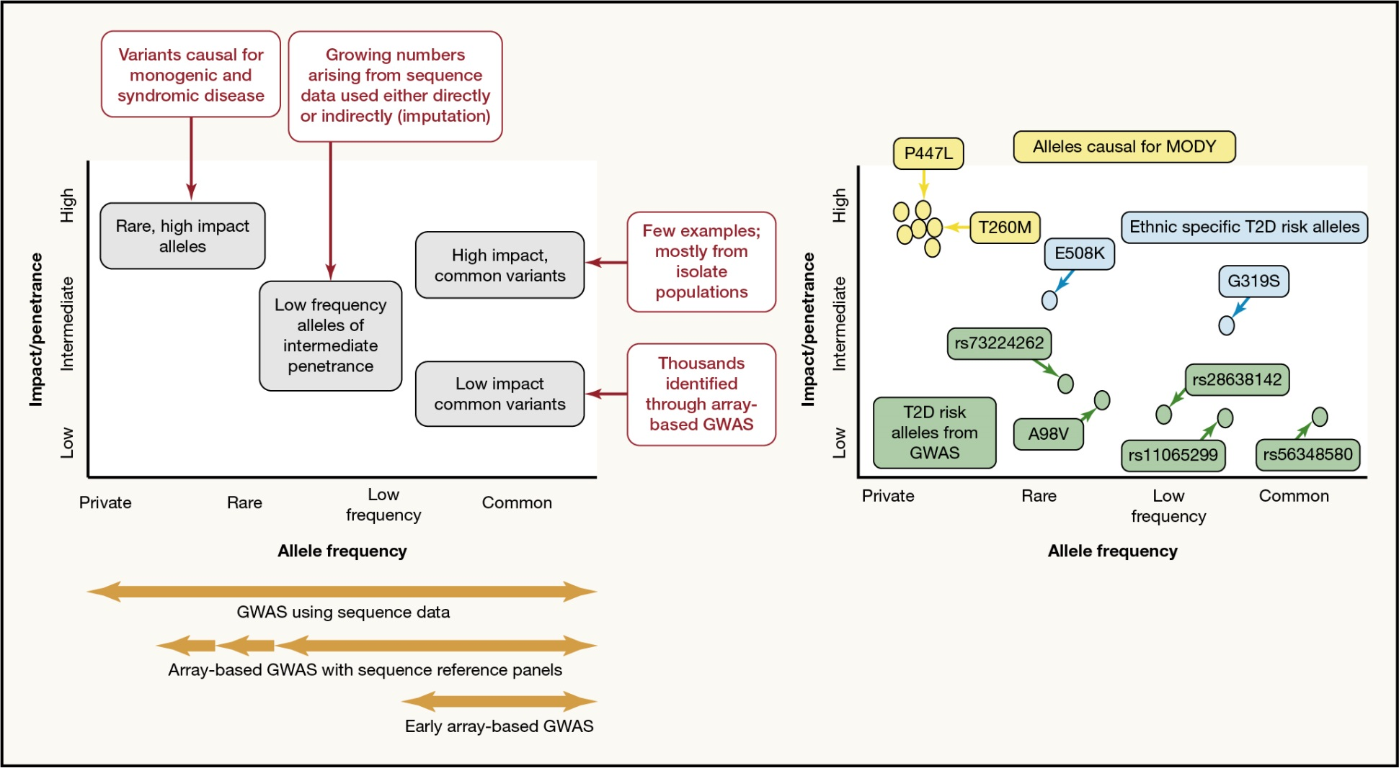
Allele Frequency Spectrum
HNF1A alleles
Barroso and McCarthy, Cell 2019

Slide 23
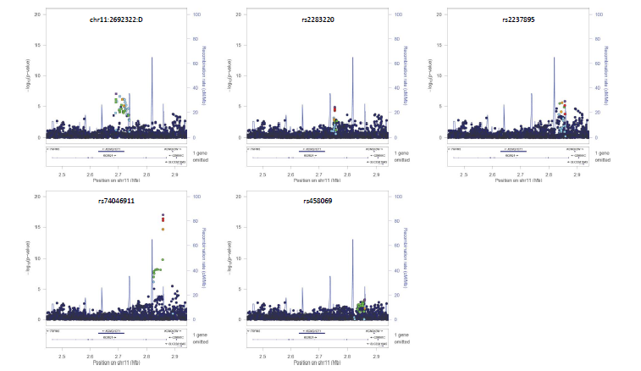
One Locus, Multiple Signals/ Causal Variants
KCNQ1 five distinct signals
Gaulton et al., 2015
Notes:
.
We see evidence of allelic heterogeneity, e.g. 5 different signals at KCNQ1.

Slide 24
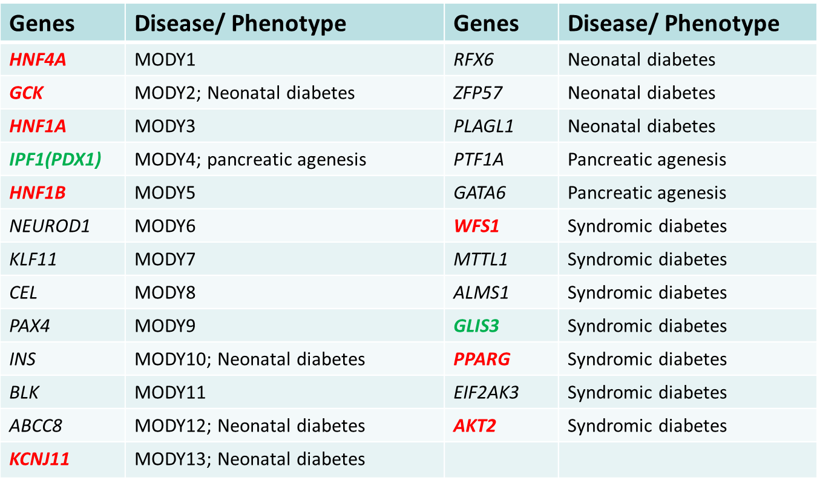
Overlap with Monogenic Disease Genes
Some diabetes or glycaemic loci overlap with monogenic diabetes loci
PAX4
Notes:
For diabetes/ glycaemic traits we are starting to detect overlap with loci that have rare mutations causing monogenic disease also harbouring more common alleles of less severe effects contributing to these more common traits/ diseases.

Slide 25
Genes Causal of Monogenic Diabetes Enriched for Rare Coding Variants that Increase Risk of Type 2 Diabetes
Monogenic OMIM gene set - allelic burden of MAF<1%, OR=1.51 p=2.8x10⁻⁵
Effect size estimates increase with increased stringency for functional annotation
  e.g. variants predicted to lead to protein truncation have a bigger effect
Fuchsberger et al., 2016
Notes:
In particular in a recent study of the GoT2D, T2DGenes consortia we have contributed to, we have found that as a group, genes that are annotated in OMIM as causal for diabetes syndromes are enriched for a burden of rare alleles MAF<1%, which collectively increase risk of diabetes by ~50%, and we note that the estimate of the effect is larger as we focus on variants that are likely to have a more severe impact on protein function, such as protein truncating alleles or missense changes predicted to be deleterious by five different software programmes.

Slide 26
What have we learned from genetic studies of type 2 diabetes and obesity?
Genetic Architecture
Architecture: "the complex or carefully designed structure of something”
Biological Insights
Translation
Notes:
But what have we learned from these studies?
Over the rest of my talk I will focus on three main aspects: genetic architecture, biological insights and clinical applications.
Genetic architecture – number, frequency and effect size of variants influencing a disease/ trait

Slide 27
Convergence of Biological Pathways
Glycaemic loci overlap some expected pathways:
  glucose metabolism, insulin secretion and processing
    SLC2A2 (glucose transporter 2)
    GCK (glucokinase)
    GCKR (Glucokinase regulatory protein)
    PCSK1 (encoding prohormone convertase 1/3, the first enzyme in the insulin processing pathway)
  transcription factors with a role in pancreatic development
    PDX1
    FOXA2
First human genetic evidence of importance circadian rhythm pathways:
  MTNR1B (one of melatonin receptors)
  CRY2 (Cryptochrome Circadian Clock 2)
Notes:
So now we have a better understanding of the genetic architecture, what biological insights have we gained from these approaches?
For glycaemic traits a number of loci overlap expected pathways involved in glucose metabolism, insulin secretion and processing but we also found for the first time human genetic evidence for the importance of circadian rhythm pathways in metabolism.

Slide 28
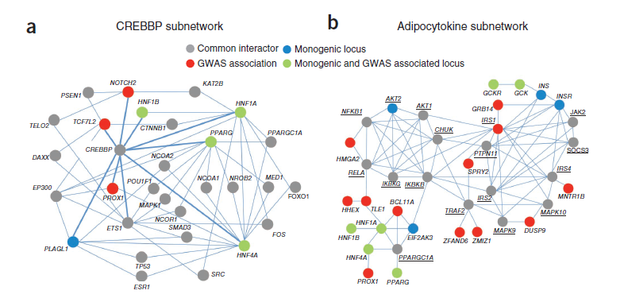
Unanticipated Biological pathways
Cell-cycle regulation – highlighted by genes coding for cyclin-dependent kinase (CDK) inhibitors (CDKN2A-CDKN2B, CDKN1C and CDKN2C) and cyclins that activate CDKs (CCNE2, CCND2 and CCNA2). Many of these regulate CDK4 or CDK6, which are known to have a role in pancreatic β-cell proliferation.
Morris et al., 2012
Notes:
And for type 2 diabetes we also identified loci that map to unanticipated pathways, e.g. cell-cycle regulation, CREBBP and adipocytokine.

Slide 29
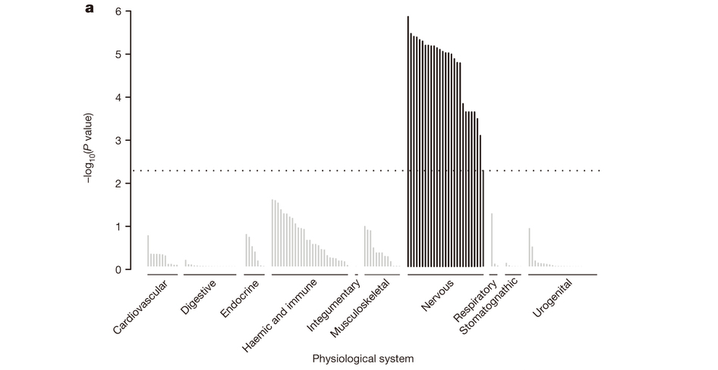
Pathways for Overall Adiposity vs Fat Distribution
BMI loci
Locke et al., 2015
Genes within BMI-associated loci are enriched for expression in brain and central nervous system
  Suggests genes are important in central control of appetite and energy expenditure
We see overlapping signals in loci mapping close to established genes involved in monogenic/ severe obesity: MC4R, POMC, SH2B1 , BDNF, BBS4
Waist-hip ratio loci
Genes within WHR-associated loci are enriched for expression in adipose tissue depots
Shungin et al., 2105
Notes:
And interesting for obesity and body fat distribution we find distinct pathways, with obesity mostly enriched for central nervous system and genes expressed in brain, suggesting important roles in central appetite control and energy expenditure, as well as overlap with known monogenic genes. And body fat distribution as measured by waist-hip ratio mostly identifying loci enriched in genes that appear to be involved in adipose tissue development, which implies a role in where excess fat is stored and also with links to insulin resistance pathways.

Slide 30
What have we learned from genetic studies of type 2 diabetes and obesity?
Genetic Architecture
Architecture: "the complex or carefully designed structure of something”
Biological Insights
Translation
Notes:
But what have we learned from these studies?
Over the rest of my talk I will focus on three main aspects: genetic architecture, biological insights and clinical applications.
Genetic architecture – number, frequency and effect size of variants influencing a disease/ trait

Slide 31
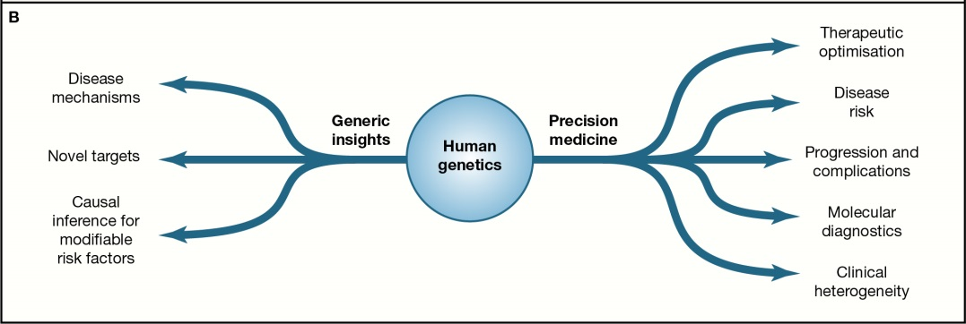
Possible Translation Avenues
Barroso and McCarthy, Cell 2019

Slide 32
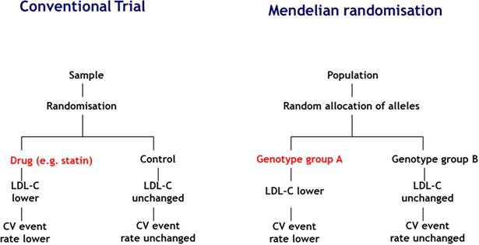
Mendelian Randomisation
Bennet et al., 2017
Genetic data => Causality

Slide 33
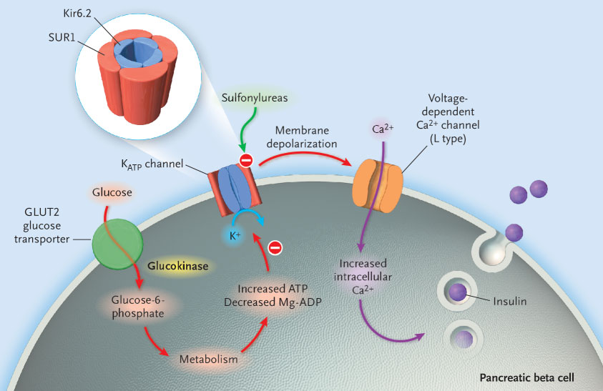
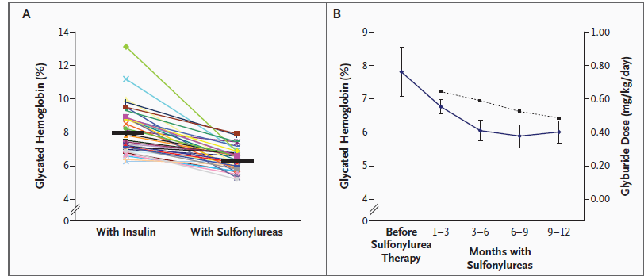
Genetic Diagnosis -> Targeted Treatment
Gloyn et al., 2004 NEJM
Molecular diagnosis of permanent neonatal diabetes
activating mutations in the gene encoding Kir6.2 subunit of ATP-sensitive potassium channel (KCNJ11)
Pearson et al., 2006 NEJM
Patients with SUR1/ KCNJ11 mutations previously on insulin shown to have better glucose control and fewer hypoglycaemic episodes on sulfonylureas

Slide 34
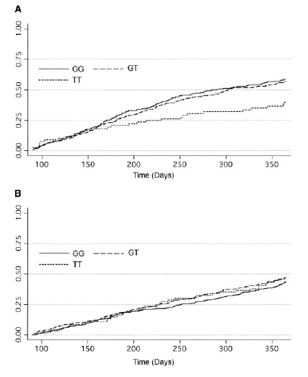
Drug Response
Sulfonylurea
rs1225372
12% of diabetes patients are homozygous for TCF7L2 rs1225372 risk allele (TT);
TT homozygous patients have a ~2-fold greater chance of not achieving HbA1c <7% (i.e. fail treatment) on sulfonylureas than the 48% of GG patients
TT
Proportion Patients who achieve target HbA1c<7%
Metformin
rs1225372
Knowledge of genotype at the TCF7L2 risk variant may influence treatment choice
Pearson et al., 2007
Notes:
Do GWAS results having any clinical implications?
Drug response example, other hits may also influence response to treatment.
TT genotype at TCF7L2 also involved in reduced response to DPP-4 inhibitors

Slide 35
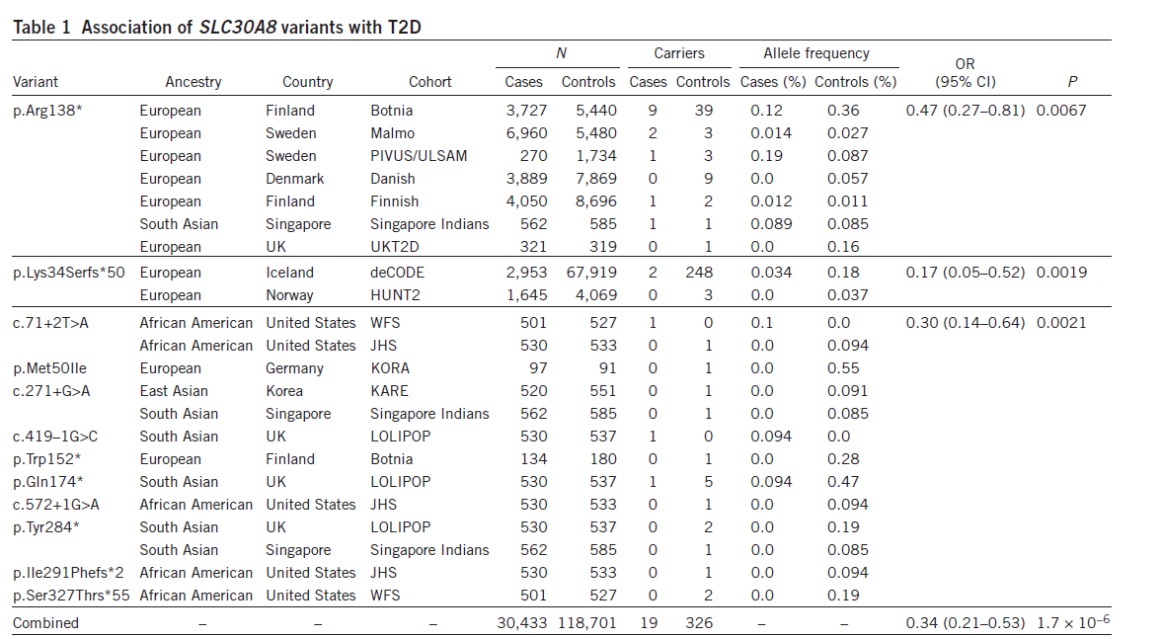
Target Discovery and Genetic Validation
Loss-of-function mutations that protect against disease risk (without other adverse effects) => validation for that gene as a target for possible therapeutic inhibition
Flannick et al., 2014
Loss-of-function mutations in SLC30A8 protect against T2D risk => New Possible Target for Inhibition
Notes:
New target identification but actual impact will take years to go through any drug development pipeline….

Slide 36
Precision Health - Variants Impacting Diagnostic Accuracy of HbA1c
G6PD variant G202A (MAF=11% in African Americans) associated with an absolute decrease in HbA1c of 0.81%units (95%CI 0.66-0.96) per allele in hemizygous men and 0.68%-units (95%CI 0.38-0.97) in homozygous women
  G6PD encodes glucose-6-phosphate dehydrogenase, mutations in G6PD cause G6PD deficiency, a haemolytic anaemia that reduces the lifespan of the erythrocyte but that confers protection against malaria
This variant could cause ~2% (650K, 95CI 550K-740K) African American adults with T2D to remain undiagnosed
Testing for G6PD variants or alternative tests may be required for individuals of African ancestry
Wheeler et al, PloS Medicine 2017

Slide 37
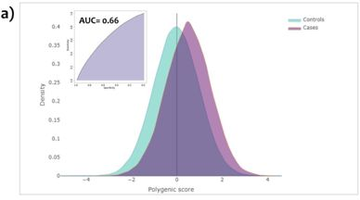
Genetic Risk Score Type 2 Diabetes
Polygenic risk score (PRS) with 136,795 variants provided maximum discrimination – equivalent to that derived from BMI, age, and sex
Individuals in the top 2.5% of PRS had 3.4-fold increased risk (prevalence = 11/2%) compared with median (prevalence =3.3%
Clinical utility of PRS still very much debated!
Mahajan et al., 2018

Slide 38
Genetic Studies of Type 2 Diabetes & Obesity
Genetic Architecture
  Most risk alleles are common, have small effect sizes, and map outside coding regions
  Some loci overlap with monogenic forms of disease
  One locus/multiple signals/ causal variants
  Role of rare variants still largely untested in sufficiently powered studies
New biological insights and unanticipated pathways
Translation opportunities
  Drug target identification
  Pharmacogenetics (drug response/ adverse reaction)
  Genetic variants to understand disease aetiology
  Genetic variants could be important for precision medicine

